Slide 1
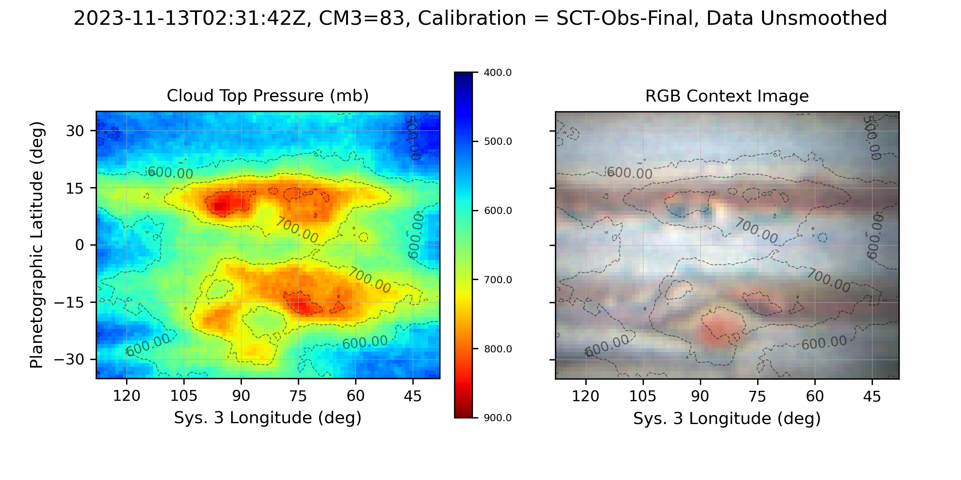
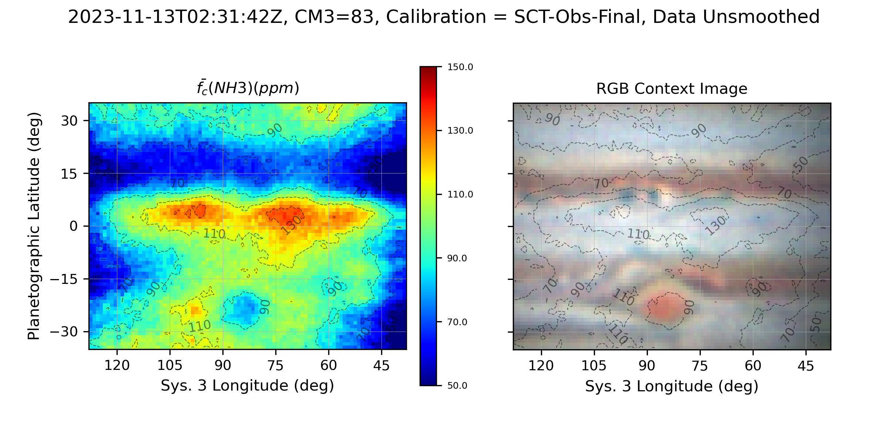
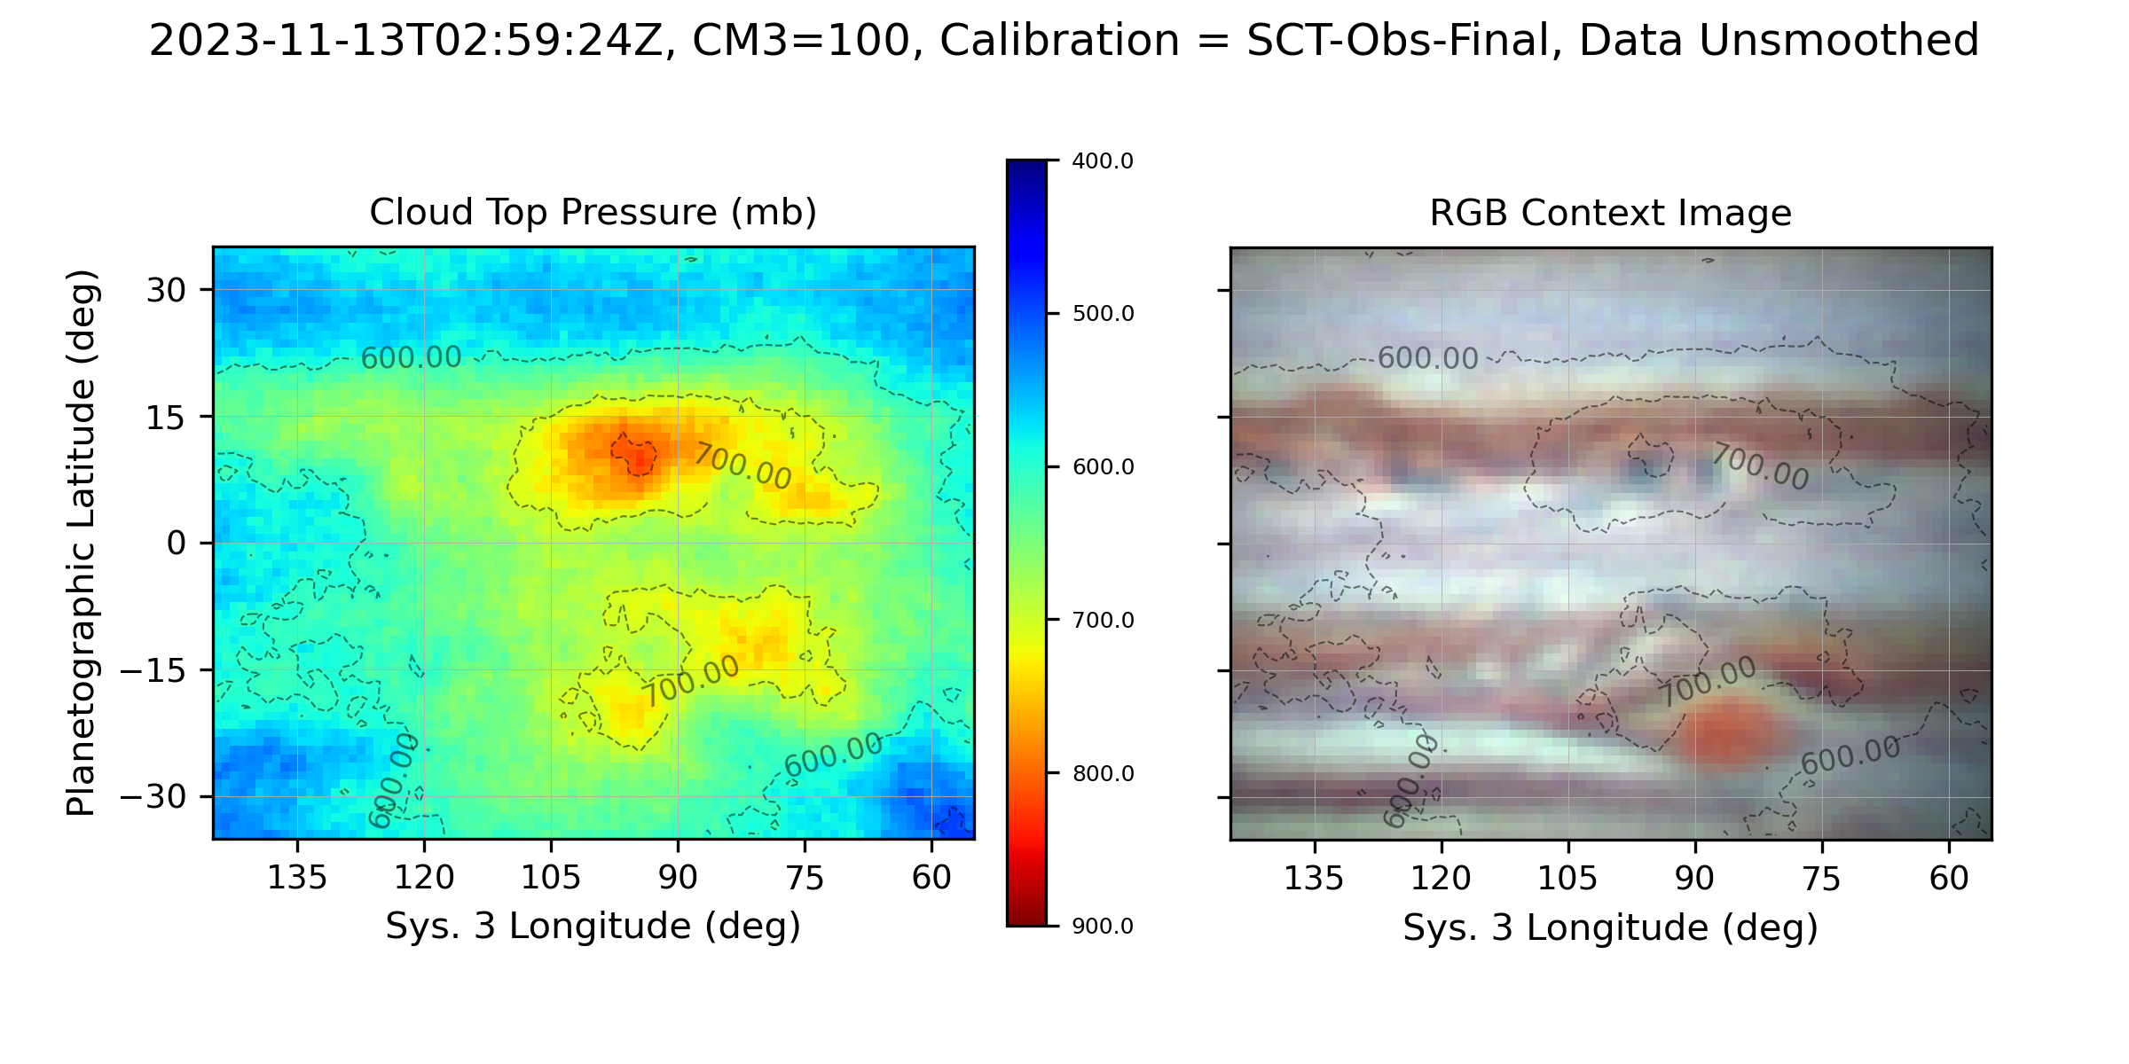
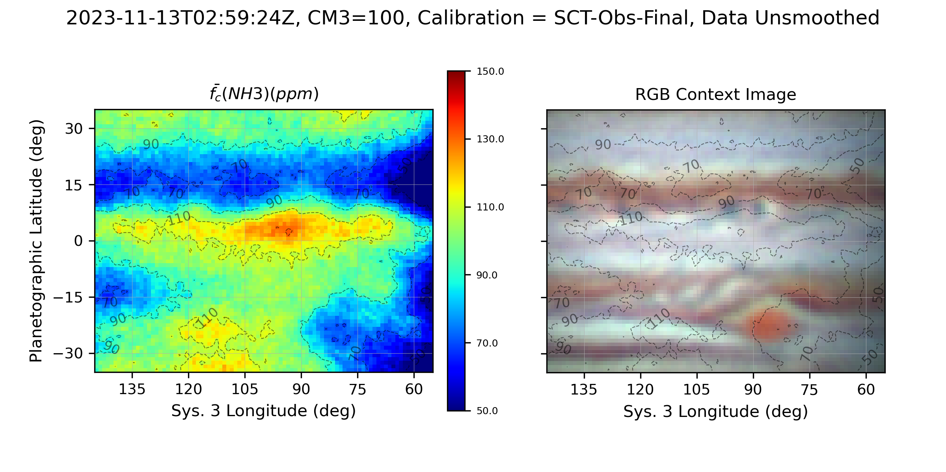
Effective Cloud Top Pressure (620 nm)
Ammonia Mole Fraction, f(NH3) (ppm)

Slide 2
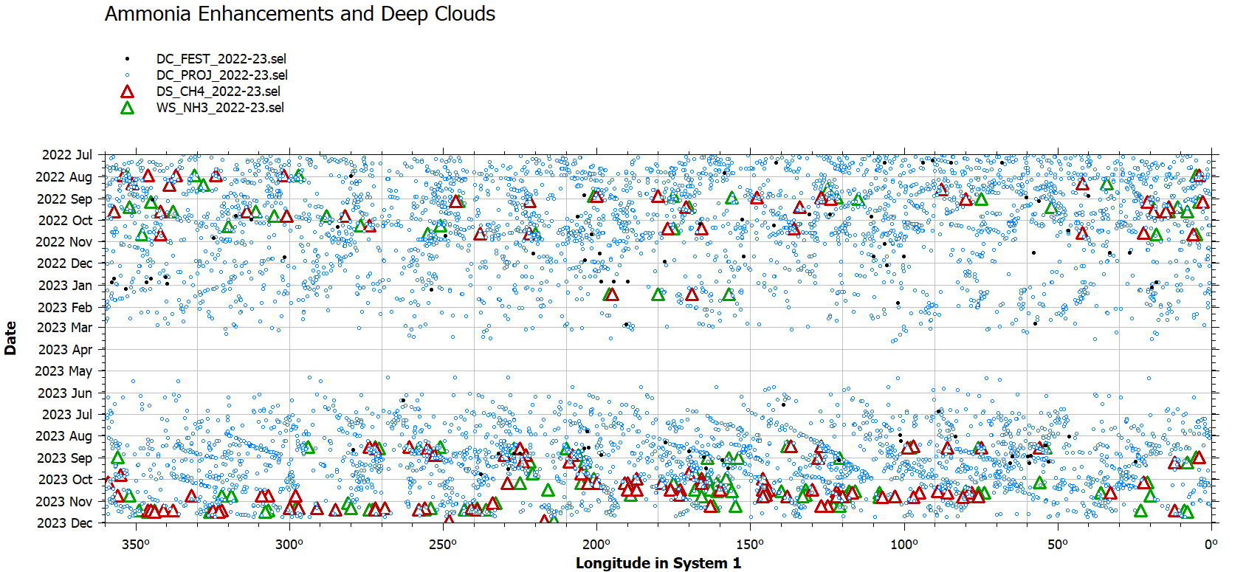
66 NH3/CH4 observations through Nov. 28, 2023
2022: 18 with SCT, 2 with VLT
2023 45 with SCT
145 CH4 cloud holes / deep clouds
146 NH3 enhanced regions
Dark Projections from WinJUPOS
Total 7082 positions between 6/1/2022 and 11/22/2023

Slide 3
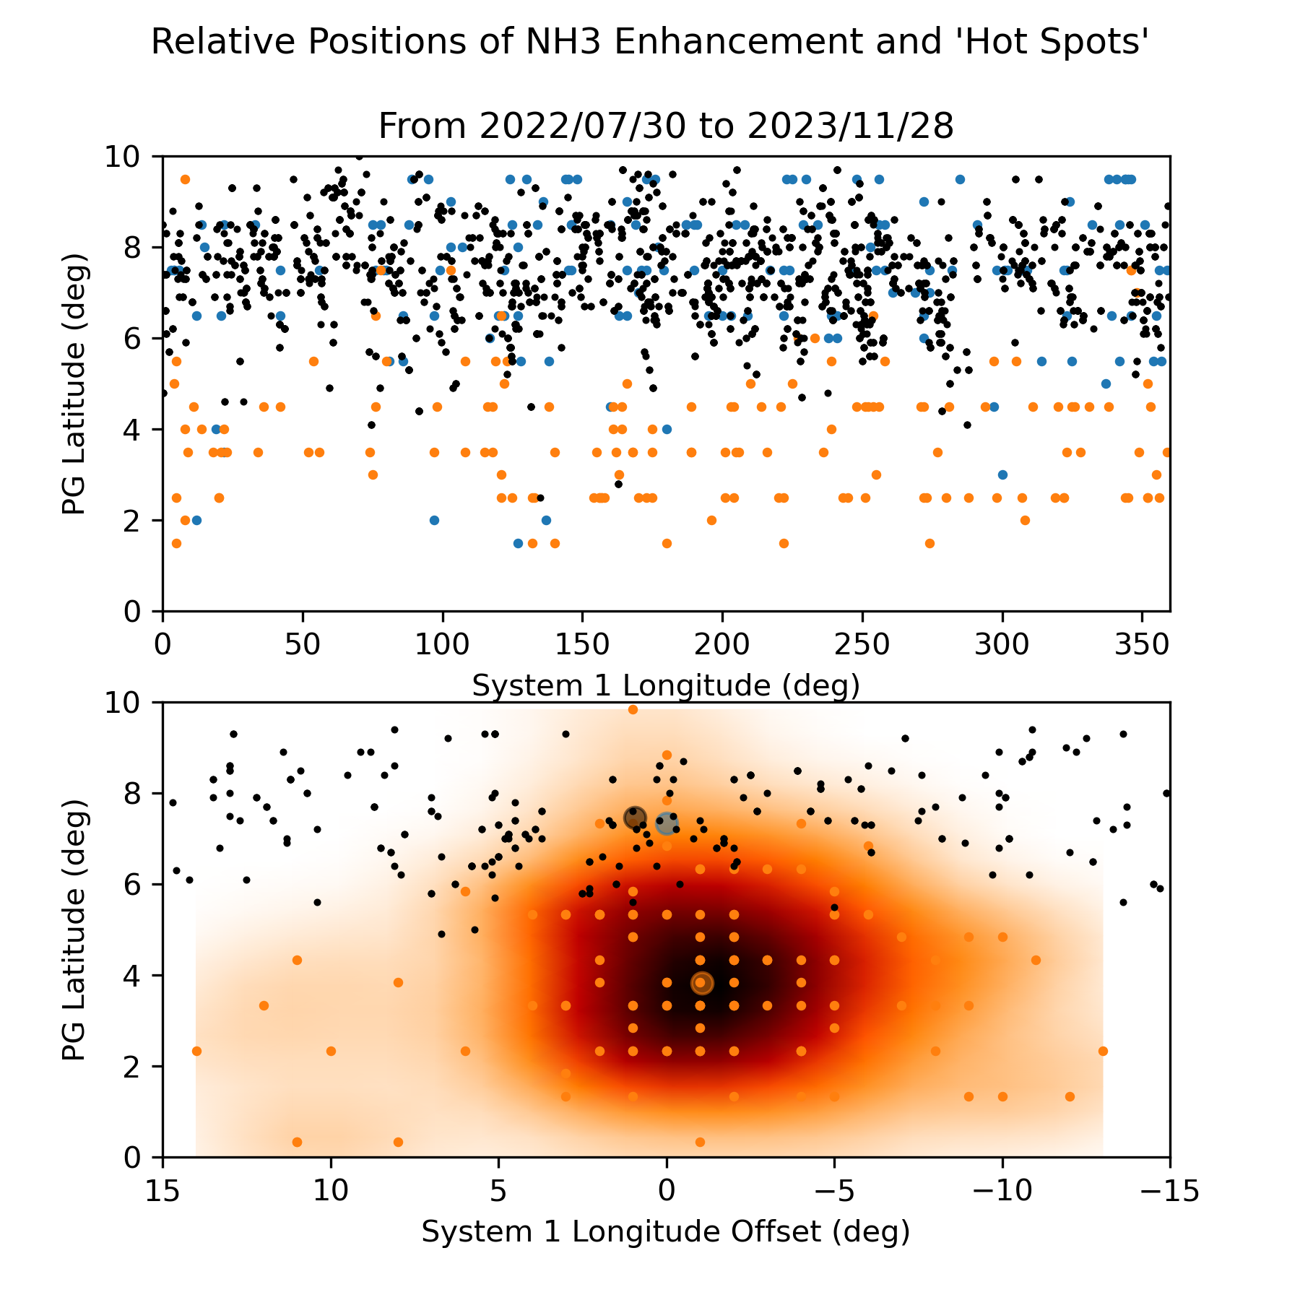
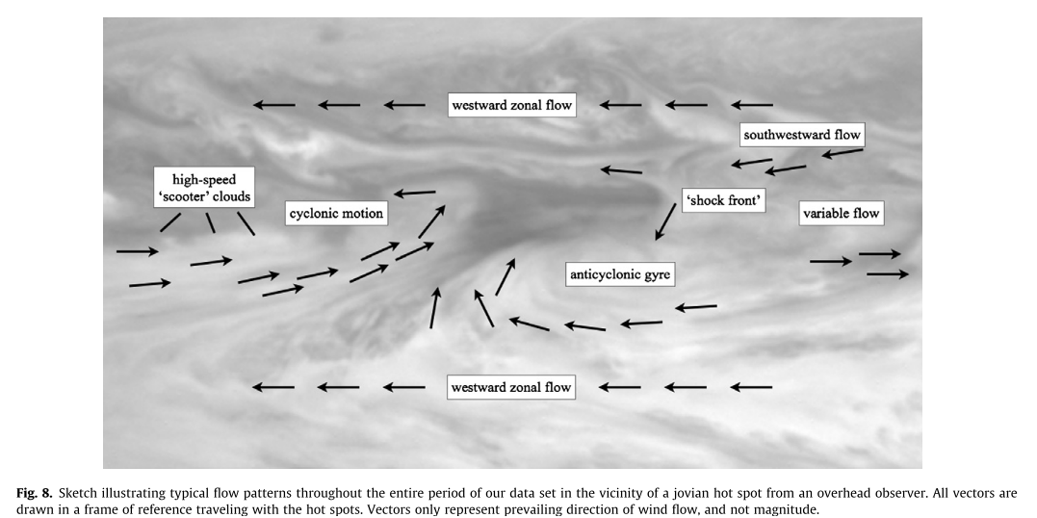
Add latitude range for CH4 deep clouds
Fix projections longitude calculation
Get lat-lon scale for Choi image

Slide 4
